Slide 1
Final Project –AWS Cloud
Architecting
Introduction
Executive Summary
Requirements & Assumptions
Architecture
Network & Security
Scalability, HA and Business Continuity
Monitoring and Auditing
Conclusion
By Shreya Karakata

Slide 2
Introduction
Problem Statement:
A start-up software-as-a-service (SaaS) medical company has started an online medical social networking and diagnosis assistance application for its users mainly residing in the United States, Europe, and the APAC region. The company wants to use the cloud services for its new application once it is launched as the current environment is using a traditional server approach which proves time-consuming and costly.
Solution:
The project highlights the use of different AWS services to help the company control the anticipated growth after launching their new application and host the development, test, and production environments through AWS cloud infrastructure. Additionally covered are the features and solutions of topics including User Authentication, Network Security, Web & Application layers, Business Continuity, & Auditing.

Slide 3
Executive Summary
The medical company currently uses an outdated method of leveraging physical resources such as servers and a hosting company to aid infrastructure development and testing of the production and development environments.
The current architecture is divided into three tiers: the web layer, the application tier, and the database tier. If the resources demand an infrastructure upgrade, this strategy can become costly, time-consuming to manage, and challenging to perform modifications and upgrades to essential applications.
The team will employ Amazon Web Services (AWS) to transition from the on-premise model to the cloud environment to meet customer needs.
The requirements:
High Availability
Scalability
Security
Utilization of Load Balancers
Supporting multiple locations

Slide 4
Requirements
The detailed customer requirements are as follows:
Configuring access permissions to conform with AWS best practices.
Building networks that conform to AWS best practices while providing all the necessary network services to the application in their different environments.
Building an architecture that matches the current server hosting company's existing architecture can handle double the number of servers.
Securing all medical information, as medical information usually contains highly sensitive personally identifiable information (PII).
Utilizing load balancers for the web and application tiers that must support HTTP, HTTPS, and TCP protocols plans to move their application into AWS.
The overview of requirements:
High Availability
Scalability
Security
Utilization of Load Balancers
Supporting multiple locations

Slide 5
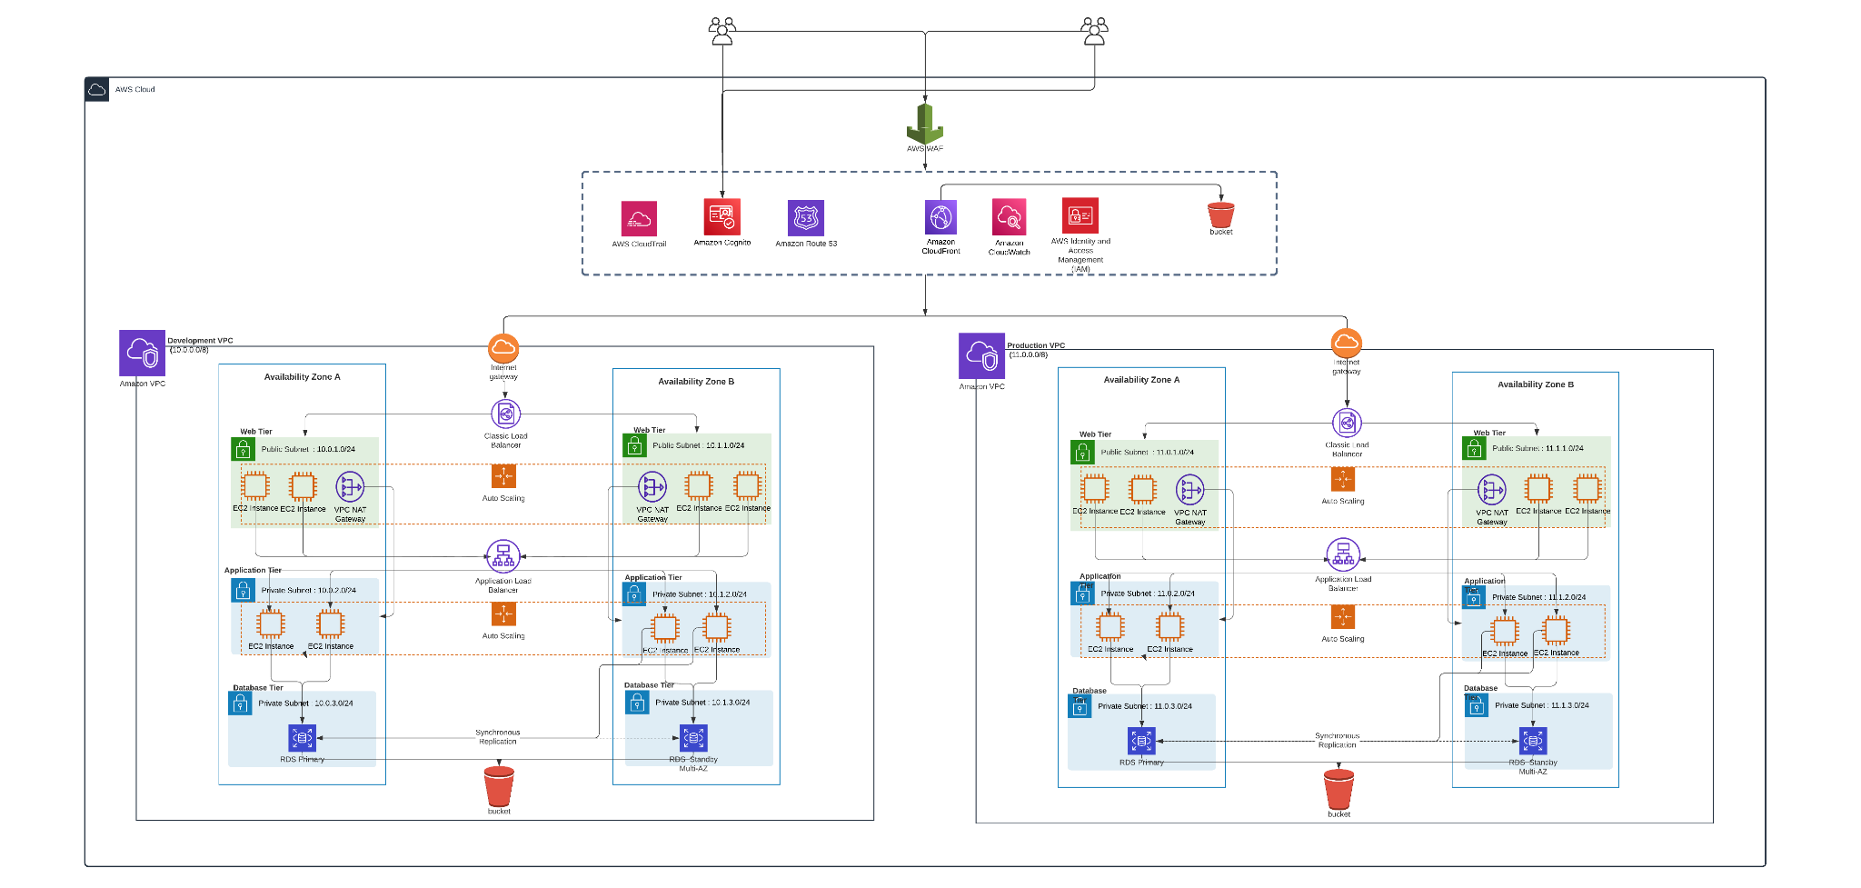
Architecture

Slide 6
AWS Services
AWS WAF (Web Application Firewall)
AWS CloudTrail
AWS Cognito
AWS Route 53
AWS CloudFront
AWS CloudWatch
AWS IAM (Identity and Access Management)
AWS S3 (Simple Storage Service)
AWS Classic Load Balancer
AWS VPC (Virtual Private Cloud)
AWS EC2 (Elastic Compute Cloud)
AWS NAT Gateway
AWS Auto Scaling Group
AWS Application Load Balancer
AWS RDS (Relational Database System)
AWS Availability Zones

Slide 7
Users and Groups
The following are the groups and users created:
A Medical Company Account
Group: System Admin
Group: Database Admin
Group: Monitor
Role: Engineer
Monitor- Supervisor
read_write_s3_ec2
System-admin-1
DB-admin-1
Monitor- EC2
System-admin-1
DB-admin-2
Monitor- S3
Monitor- RDS
7

Slide 8
User Authentication
The groups and their associated roles are as follows:
Group/Role # | Group/Role Name | Permissions
Group | System Administrator | AWS Console Management Access Programmatic Access
Group | Database Administrator | AWS Console Management Access Programmatic Access
Group | Monitor | AWS Console Management Access
Role | read_write_s3_ec2 | AWS Console Management Access

Slide 9
User Authentication
The following are the solutions for user authentication requirements:
Requirement | Solution
Should be at least 8 characters and have 1 uppercase, 1 lowercase, 1 special character, and a number. | Checking the following in IAM Password Policy: Enforce password minimum length : 8 characters Require at least one uppercase letter Require at least one lowercase letter Require at least one number Require at least one non-alphanumeric character
Change passwords every 90 days and ensure that the previous three passwords can’t be re-used. | Checking the following in IAM Password Policy: Enable password expiration : 90 days Prevent password reuse : 3
All administrators require programmatic access | Give administrator groups programmatic access through IAM groups
Administrator sign-in to the AWS Management Console requires the use of Virtual MFA. | Enable virtual MFA for administrator groups

Slide 10
Network and Security
The VPC and Subnet details for each VPC are as follows:
VPC | Region | Purpose | Subnets (Each AZs) | AZs | CIDR Range
1 | us-east-1 | Development | 1 public (web tier) 2 private( app and db tier) | use1-az1 use1-az2 | 10.0.0.0/8
2 | us-east-1 | Production | 1 public (web tier) 2 private( app and db tier) | use1-az1 use1-az2 | 11.0.0.0./8
Development VPC
Subnet Name | VPC | Subnet Type (Public/private) | AZ | Subnet Address
dev_web_pub_1 | #1 | Public | 1 | 10.0.1.0/24
dev_web_pub_2 | #1 | Public | 2 | 10.1.1.0/24
dev_app_priv_1 | #1 | Private | 1 | 10.0.2.0/24
dev_app_priv_2 | #1 | Private | 2 | 10.1.2.0/24
dev_db_priv_1 | #1 | Private | 1 | 10.0.3.0/24
dev_db_priv_2 | #1 | Private | 2 | 10.1.3.0/24

Slide 11
Network and Security
Production VPC
Subnet Name | VPC | Subnet Type (Public/private) | AZ | Subnet Address
prod_web_pub_1 | #2 | Public | 1 | 11.0.1.0/24
prod_web_pub_2 | #2 | Public | 2 | 11.1.1.0/24
prod_app_priv_1 | #2 | Private | 1 | 11.0.2.0/24
prod_app_priv_2 | #2 | Private | 2 | 11.1.2.0/24
prod_db_priv_1 | #2 | Private | 1 | 11.0.3.0/24
prod_db_priv_2 | #2 | Private | 2 | 11.1.3.0/24

Slide 12
Web, Application and Database Tier
The following are the type and size of instances in each tier
Tier | Tag* | OS | Type | Size | Justification | # of instances | User Data?
Web | Key = Name Value = web-tier | MS Windows 2016 | t3 medium | 4 GB Memory | For the size and it is required for a high network performance | 2 | Yes
App | Key = Name Value = app-tier | MS Windows 2016 | t3 large | 16 GB Memory | For the size and it is required for a high network performance and less interference | 2 | Yes
DB | Key = Name Value = db-tier | MS Windows with SQL server SE | db.t3 3x large | 32 GB Memory, 5TB Storage | For the size and to support all on-demand services | 1 | No

Slide 13
Web, Application and Database Tier
The following gives information about the load balancer and security groups
Load Balancer | Name* | External/ Internal | Subnets | SG Name* | Rule | Source
For Web Tier | web-elb | External | prod_web_pub_1 prod_web_pub_2 | web-elb-sg | Inbound port 80 and 443 | 80 (Internet)
For App Tier | app-elb | Internal | prod_app_priv_1 prod_app_priv_2 | app-elb-sg | Inbound port 8080 | 8080 (Web Tier)
Instance Tier | SG Name* | Rule | Source
Web Tier | web-tier-sg | Inbound port 80 Receives requests from web tier load balancer | web-elb
App Tier | app-tier-sg | Inbound port 80 Receives requests from application tier load balancer | app-elb
Database Tier | db-tier-sg | Inbound port 1433 Receives requests from application tier | App Tier

Slide 14
Business Continuity
The following are the autoscaling details:
Tier | OS | Type | Size | Configuration Name* | Role | Security Group
Web | Microsoft Windows | (t3) medium | 4 CPU , 8 GB | WebTier | read_write_s3_ec2 | System admin
App | Microsoft Windows | (t3) xlarge | 6 CPU , 32 GB | AppTier | read_write_s3_ec2 | System admin
Tier | Launch Configuration* | Group Name* | Group Size | VPC | Subnets | ELB | Tags
Web | WebTier | WebTier | Min : 2 Max 4 | Production | prod_web_pub_1 prod_web_pub_2 | web-elb | Key =Name Value =web-tier
App | AppTier | AppTier | Min : 2 Max 4 | Production | prod_app_priv_1 prod_app_priv_2 | app-elb | Key =Name Value =app-tier

Slide 15
Auditing & Next Steps
When Auditing AWS it is recommended to do the following:
Secure IAM : IAM is frequently over-privileged, therefore we want to ensure that we have a sound plan for dealing with it. (Shadow IT)
AWS Cloud Trail: Audit logs are critical for spotting unusual occurrences and understanding what happened after an event. CloudTrail is essentially an auto-log of every action that occurs in AWS.
AWS Cognito: Amazon Cognito helps to quickly and easily add user sign-up, user sign-in, and access control to your online and mobile apps.
VPC Logs: Data regarding network traffic in VPC is captured and logged using VPC Flow logging.
AWS Config: AWS Config offers an inventory of AWS resources, a history of configurations, and alerts of configuration changes to facilitate security and control.
Next steps:
Add more security controls.
Guard Duty- Amazon Guard Duty helps with analyzing your entire AWS environment for potential threats.
Inspector-Amazon Inspector provides you with security assessments of your applications settings and configurations on your EC2 instances

Slide 16
Conclusion
This design is built considering the best practices for the AWS architecture.
The cloud solution architecture is designed to help the Startup shift from on-premises architecture to AWS cloud infrastructure and to meet client requirements such as high availability, scalability, security, load balancing, and support for many locations.
We have also implemented other necessary requirements including:
the usage of virtual MFA
16 character password policy.
The usage of multiple zone server deployment also ensures that the application is fault-tolerant and resilient.
Private subnetting to maintains the confidentiality of sensitive information.
AWS-related operations made on the infrastructure will also be tracked and audited by the administrators.

Slide 17
Thank You

